Slide 1





Design & Build Project
Group : 34

Slide 2
01
Hardware Model and Control Software - Telecom
02
Object Detection Software - IoT
03
Database Management and Web Visualisation - E-Commerce
05

Slide 3
Hardware Model and Control Software
Telecom

Slide 4
01
Design ideas
02
Specific function
Directory
Technical solution and development process
03
04
Results and appearance display
05

Slide 5
01
Design ideas

Slide 6
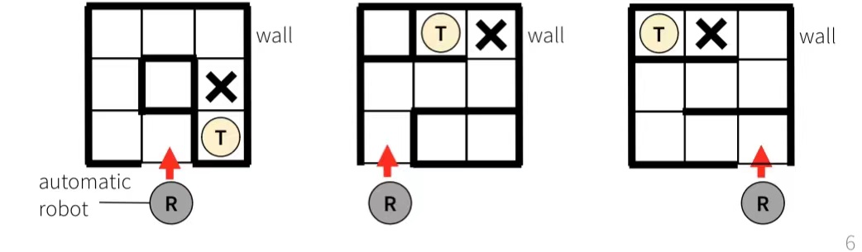
Design ideas
We design and build a prototype of a robot control system that uses an automatic robot to explore a walled maze with a hidden treasure inside. The robot finds the route through the maze and locate the hidden treasure. We use the camera to take pictures of the treasure and identify the type of treasure using object detection algorithm.
The robot also reports the map of the maze, the time of exploration and the pictures taken. We have make a web application that provides current and historical exploration records. And we have a database be designed to manage all information for the whole system.

Slide 7
Design ideas
This design takes the arduino mega 2560 development board as the core, controls the motor drive module through the L298N two-way DC motor, and completes the forward and turning actions of the trolley through five-way addressing and ultrasonic sensors. Through the ultrasonic ranging module at the front of the car and the motor module of the trolley, the obstacle avoidance function of the trolley is realized; Through five-way addressing, the tracking function of the trolley is realized.
The design of this paper reserves an expansion interface, which can expand the Bluetooth control module and servo module on the basis of the obstacle avoidance module, so that the car has stronger intelligence. The overall block diagram of obstacle avoidance is shown in the following figure:
Power supply module
Trail module
Program system
Arduino Mega 2560 development board
Obstacle avoidance module
Motor drive module
Bluetooth module

Slide 8
02
Specific function

Slide 9




Travel direction and turning: we use three ultrasonic sensors to control the direction of travel of the trolley, the current sensor perception distance is less than a certain value when the turn is triggered, the sensors on both sides measure the distance separately, when the left distance is greater than the right, the trolley turns left; When the right distance is greater than the left, the trolley turns right.
Identify colors: Use color sensors to identify different colors to find treasures.
Five-way tracking: Based on the infrared reflection sensor, the infrared emitting diode of the sensor continuously emits infrared rays, and when the emitted infrared rays are reflected by the object, they are collected by the infrared receiver and output analog values. The output analog value is related to the distance of the object and the color of the object. By calculating the analog value of the five outputs, the position of the trace line is judged to realize that the smart car can drive along the black line.
Bluetooth: Remote control of the trolley via Bluetooth.
WIFI: wifi controls camera photography and video, takes three photos per second and uploads data to IoT for the next step.

Slide 10
03
Technical solution and development process
Notes:
specific function

Slide 11
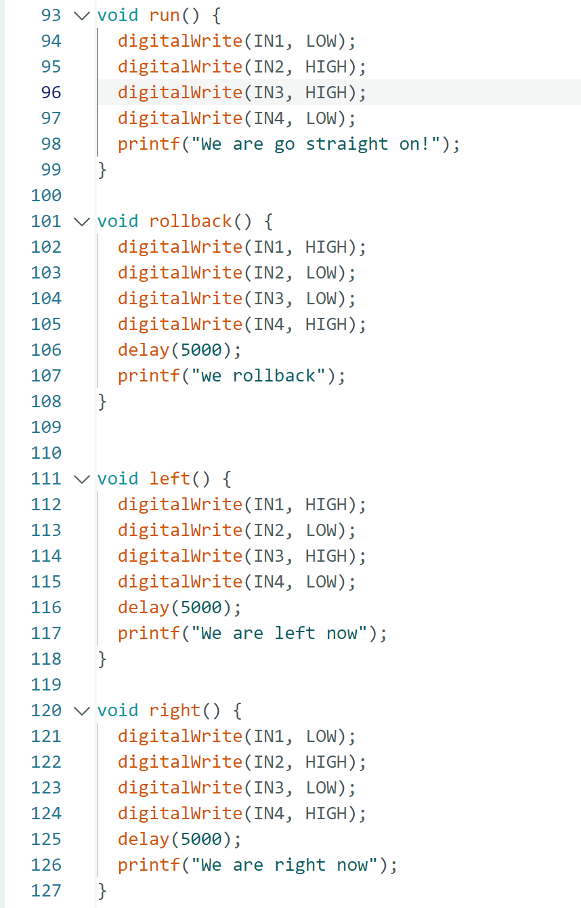
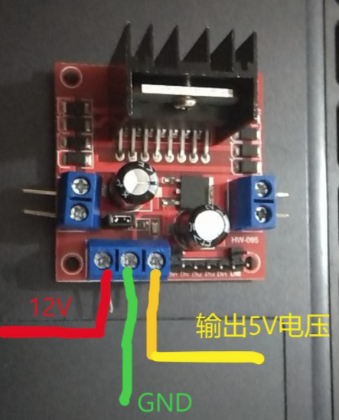
First of all, we assemble the basic part of the intelligent car, and then the functions of the intelligent car are divided into motor drive module, obstacle avoidance module, tracking module and detection module. We design the software for each module individually, and finally assemble the hardware into the trolley.
Motor drive module
The wiring method of the drive module.

Slide 12
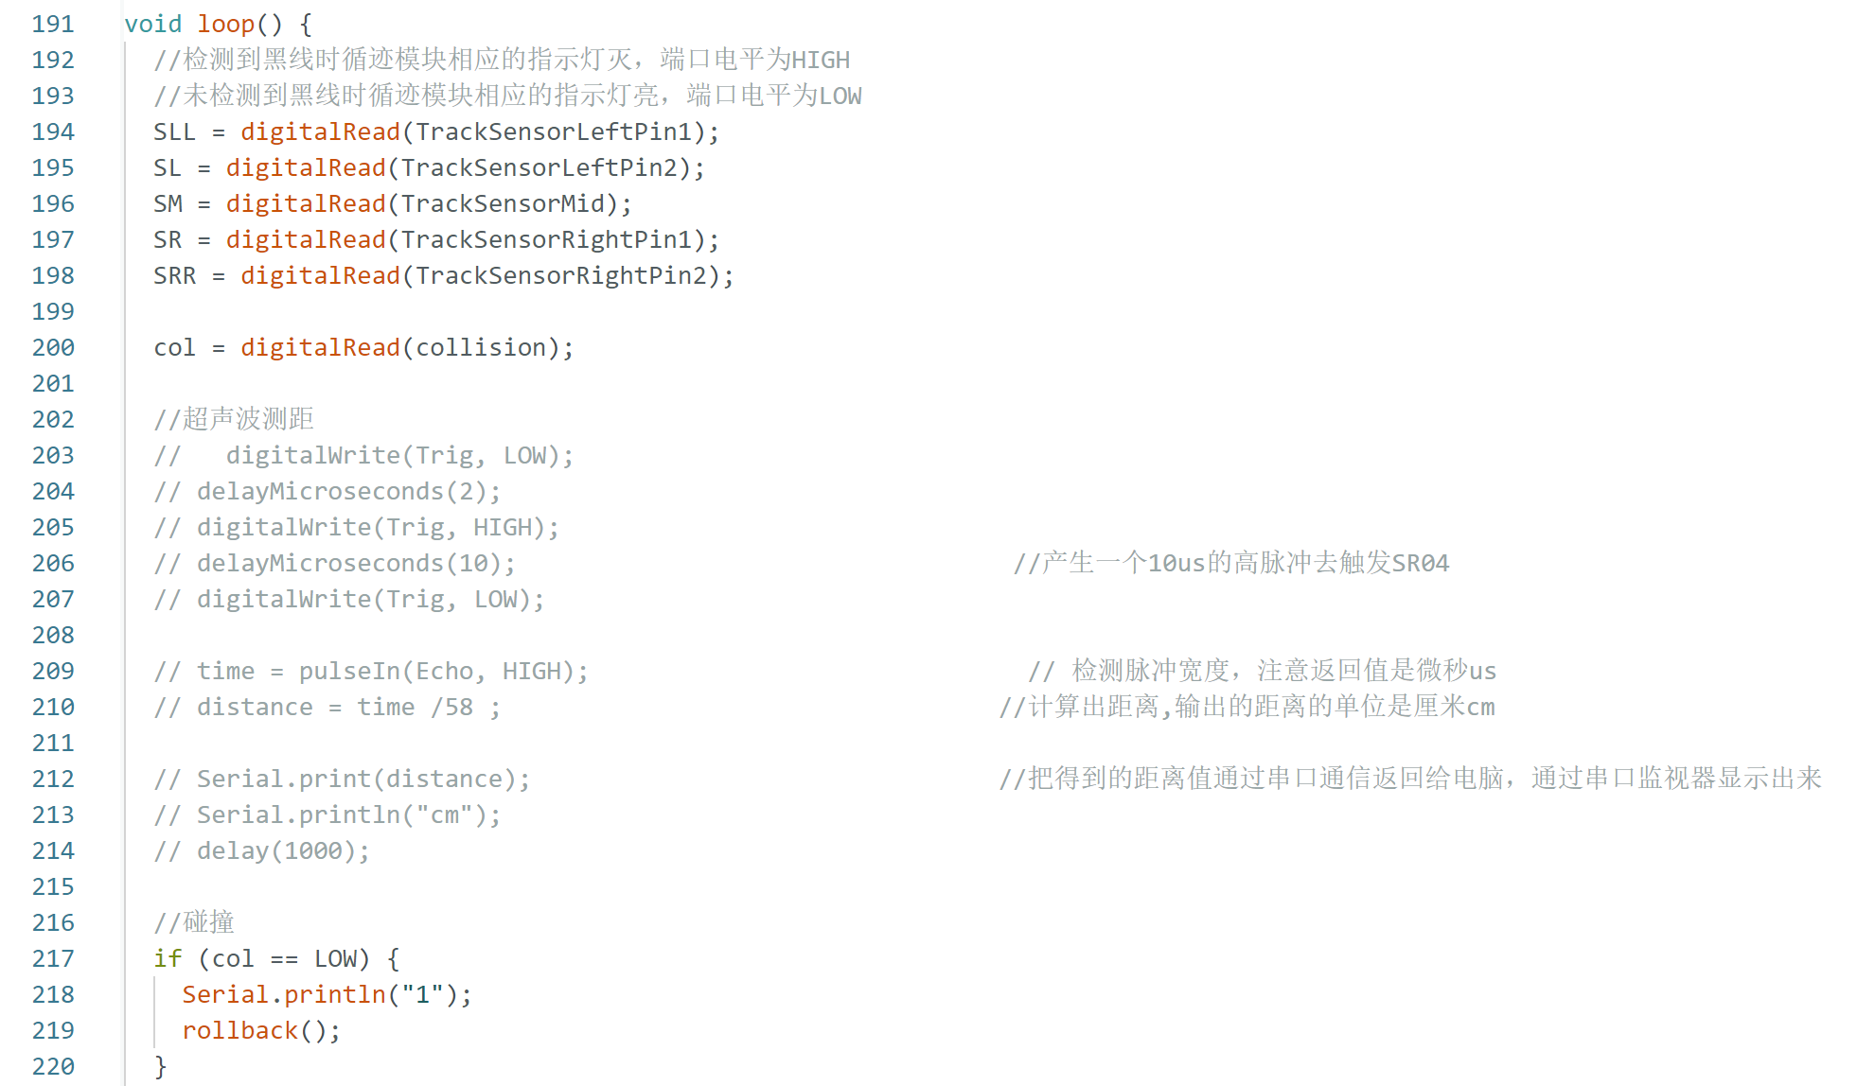
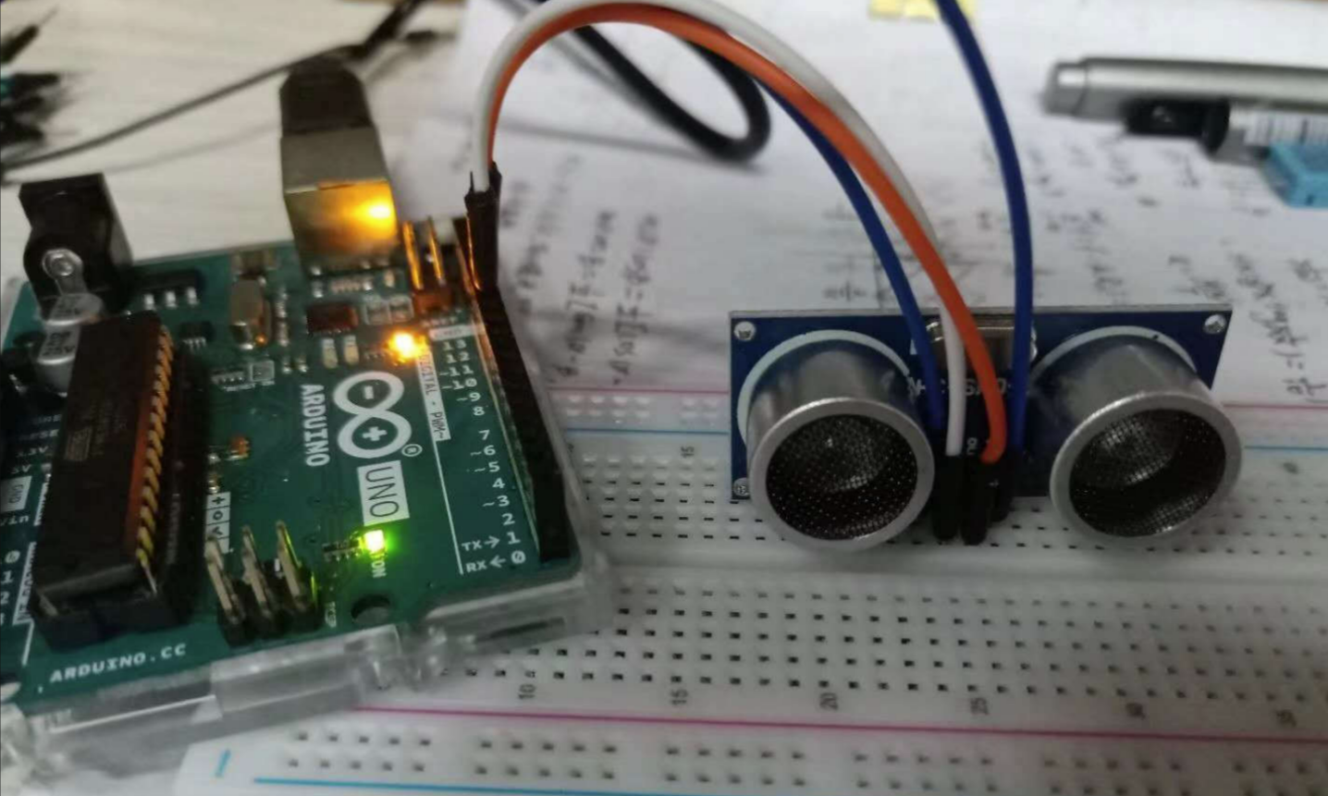
Obstacle avoidance module
We use ultrasonic sensors to realize obstacle avoidance function, when the trolley turns left, the left front and left rear wheels turn back; The two wheels of right front and right rear turn forward; When the trolley turns right, the left front and left rear wheels turn forward; The right front and right rear wheels turn back.

Slide 13
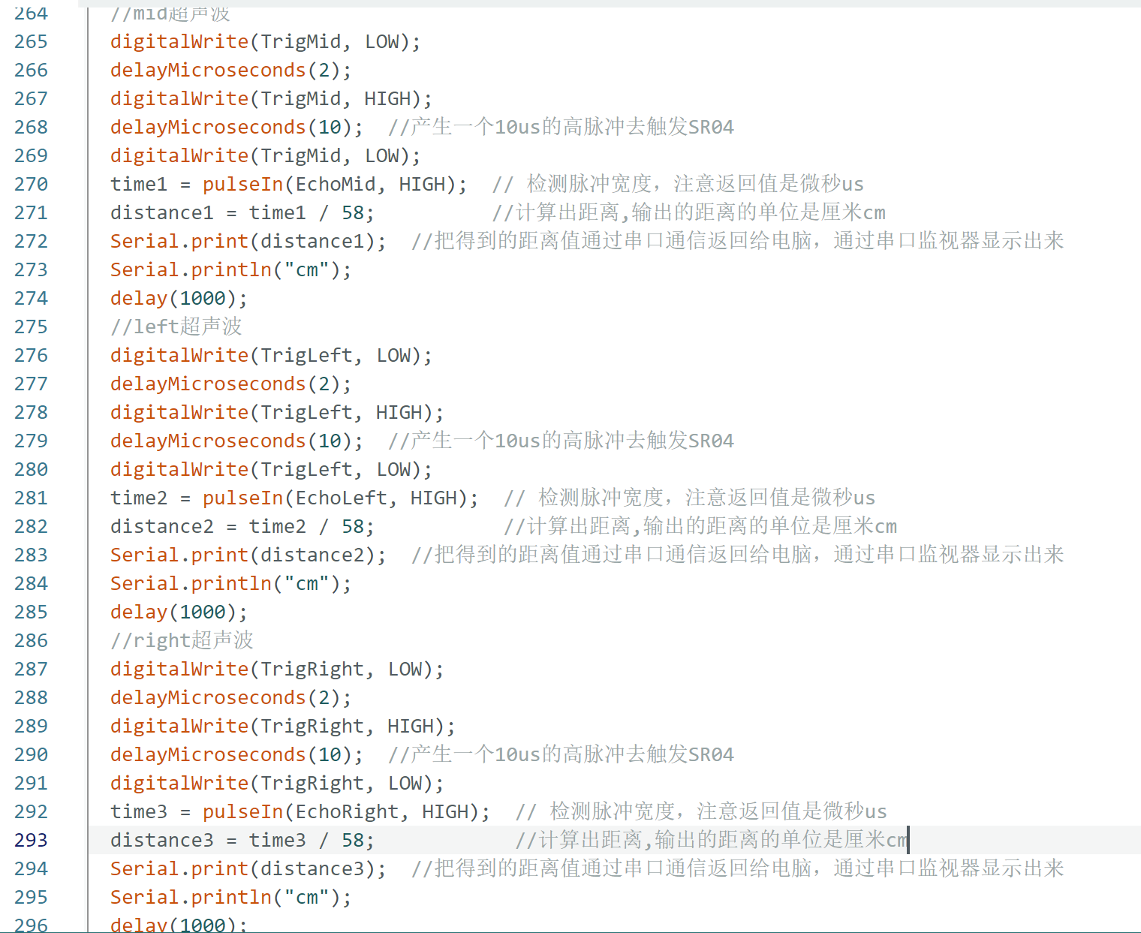
Obstacle avoidance module

Slide 14
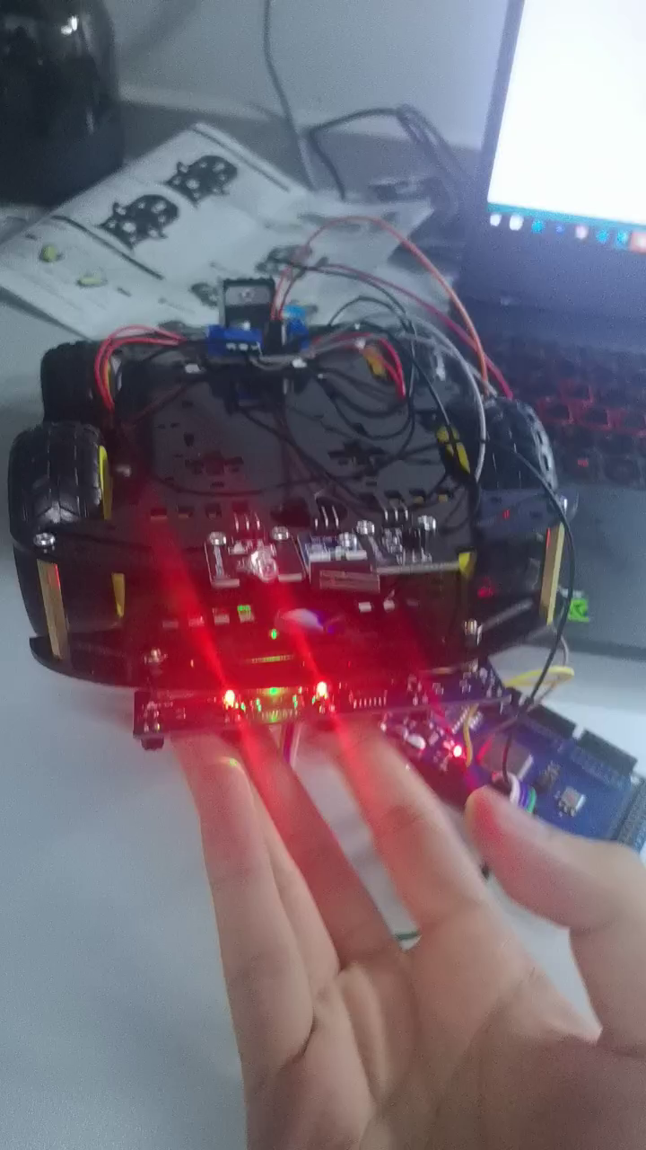
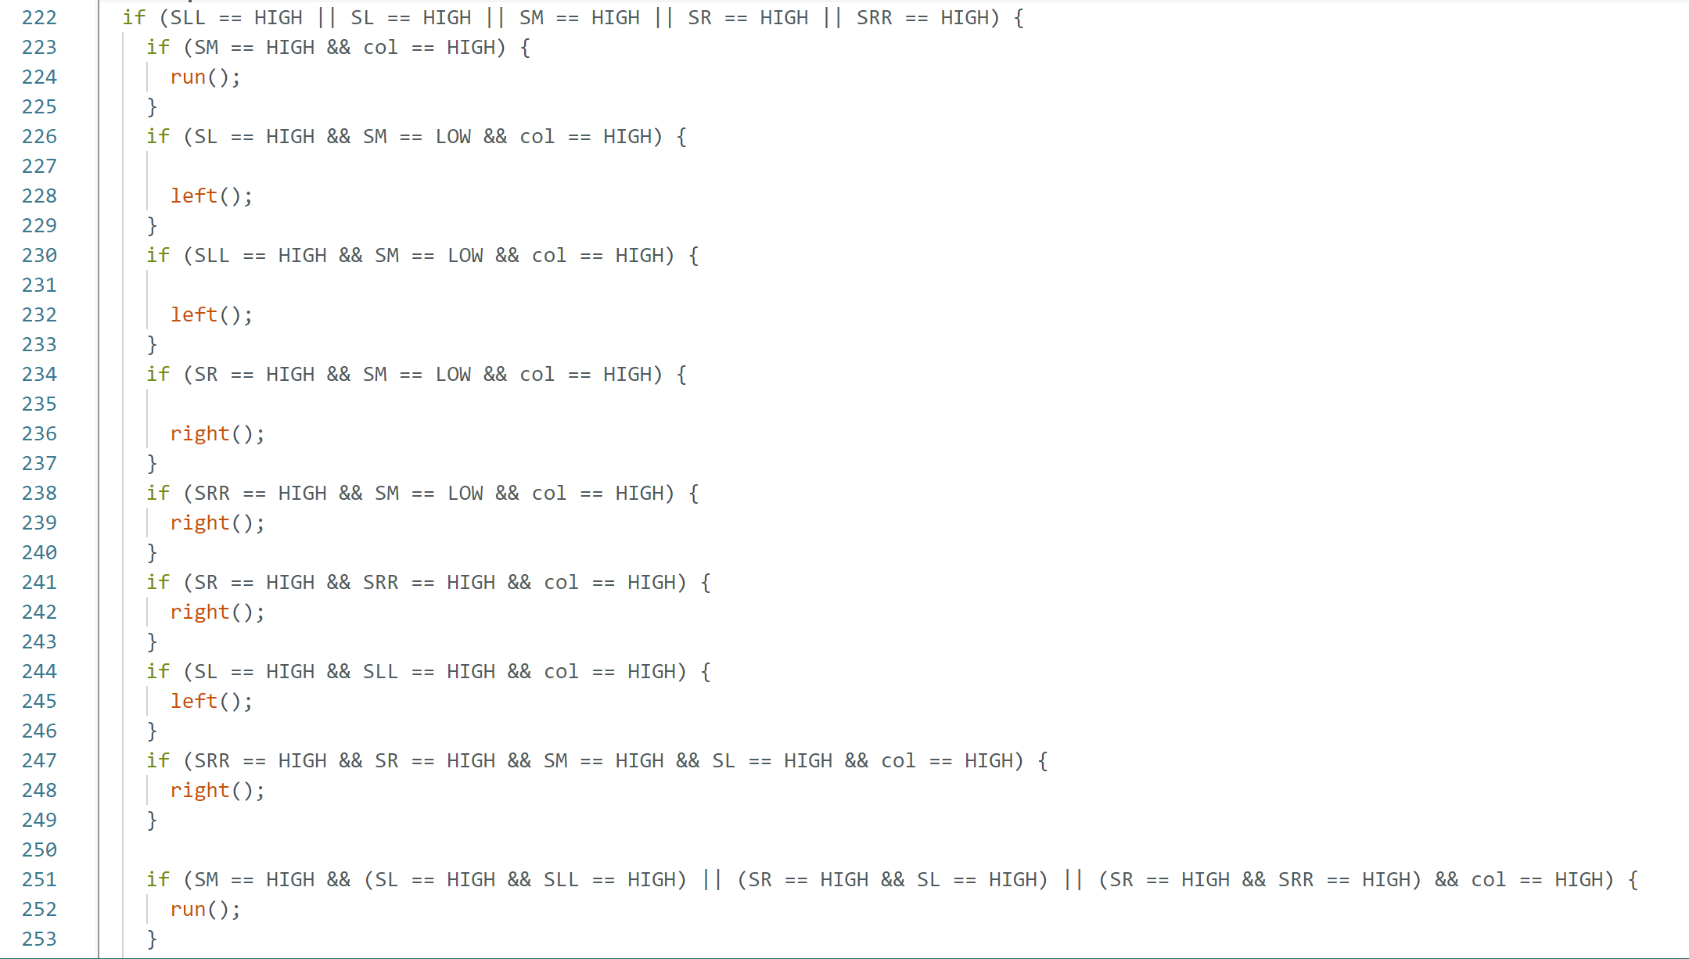
Trail module

Slide 15
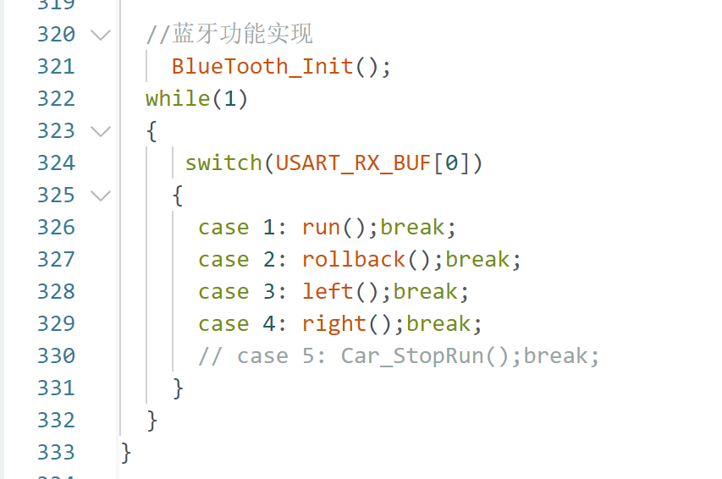
Additional features
Bluetooth module

Slide 16
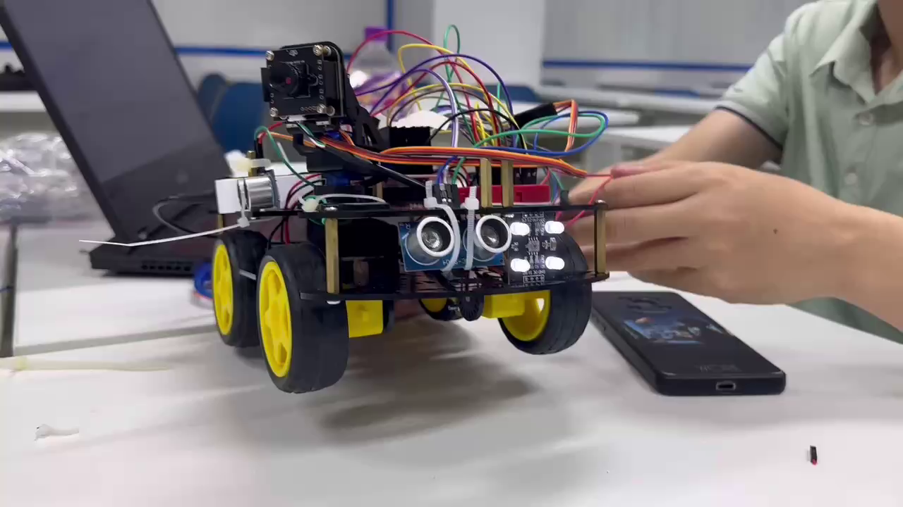
Detection module
舵机

Slide 17
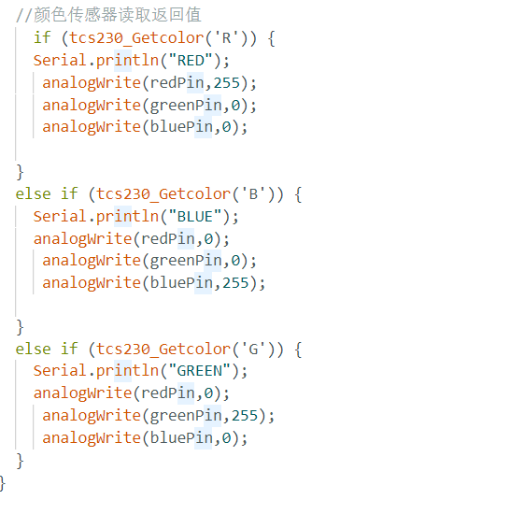
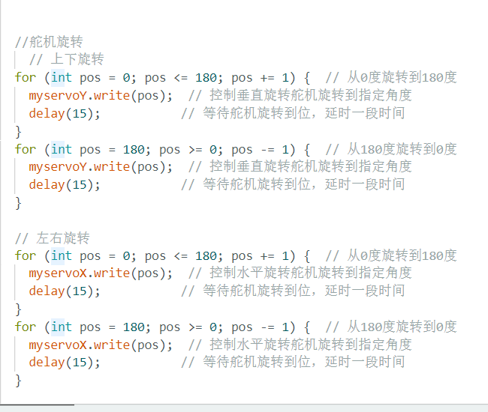

Slide 18
04
Results and appearance display.

Slide 19
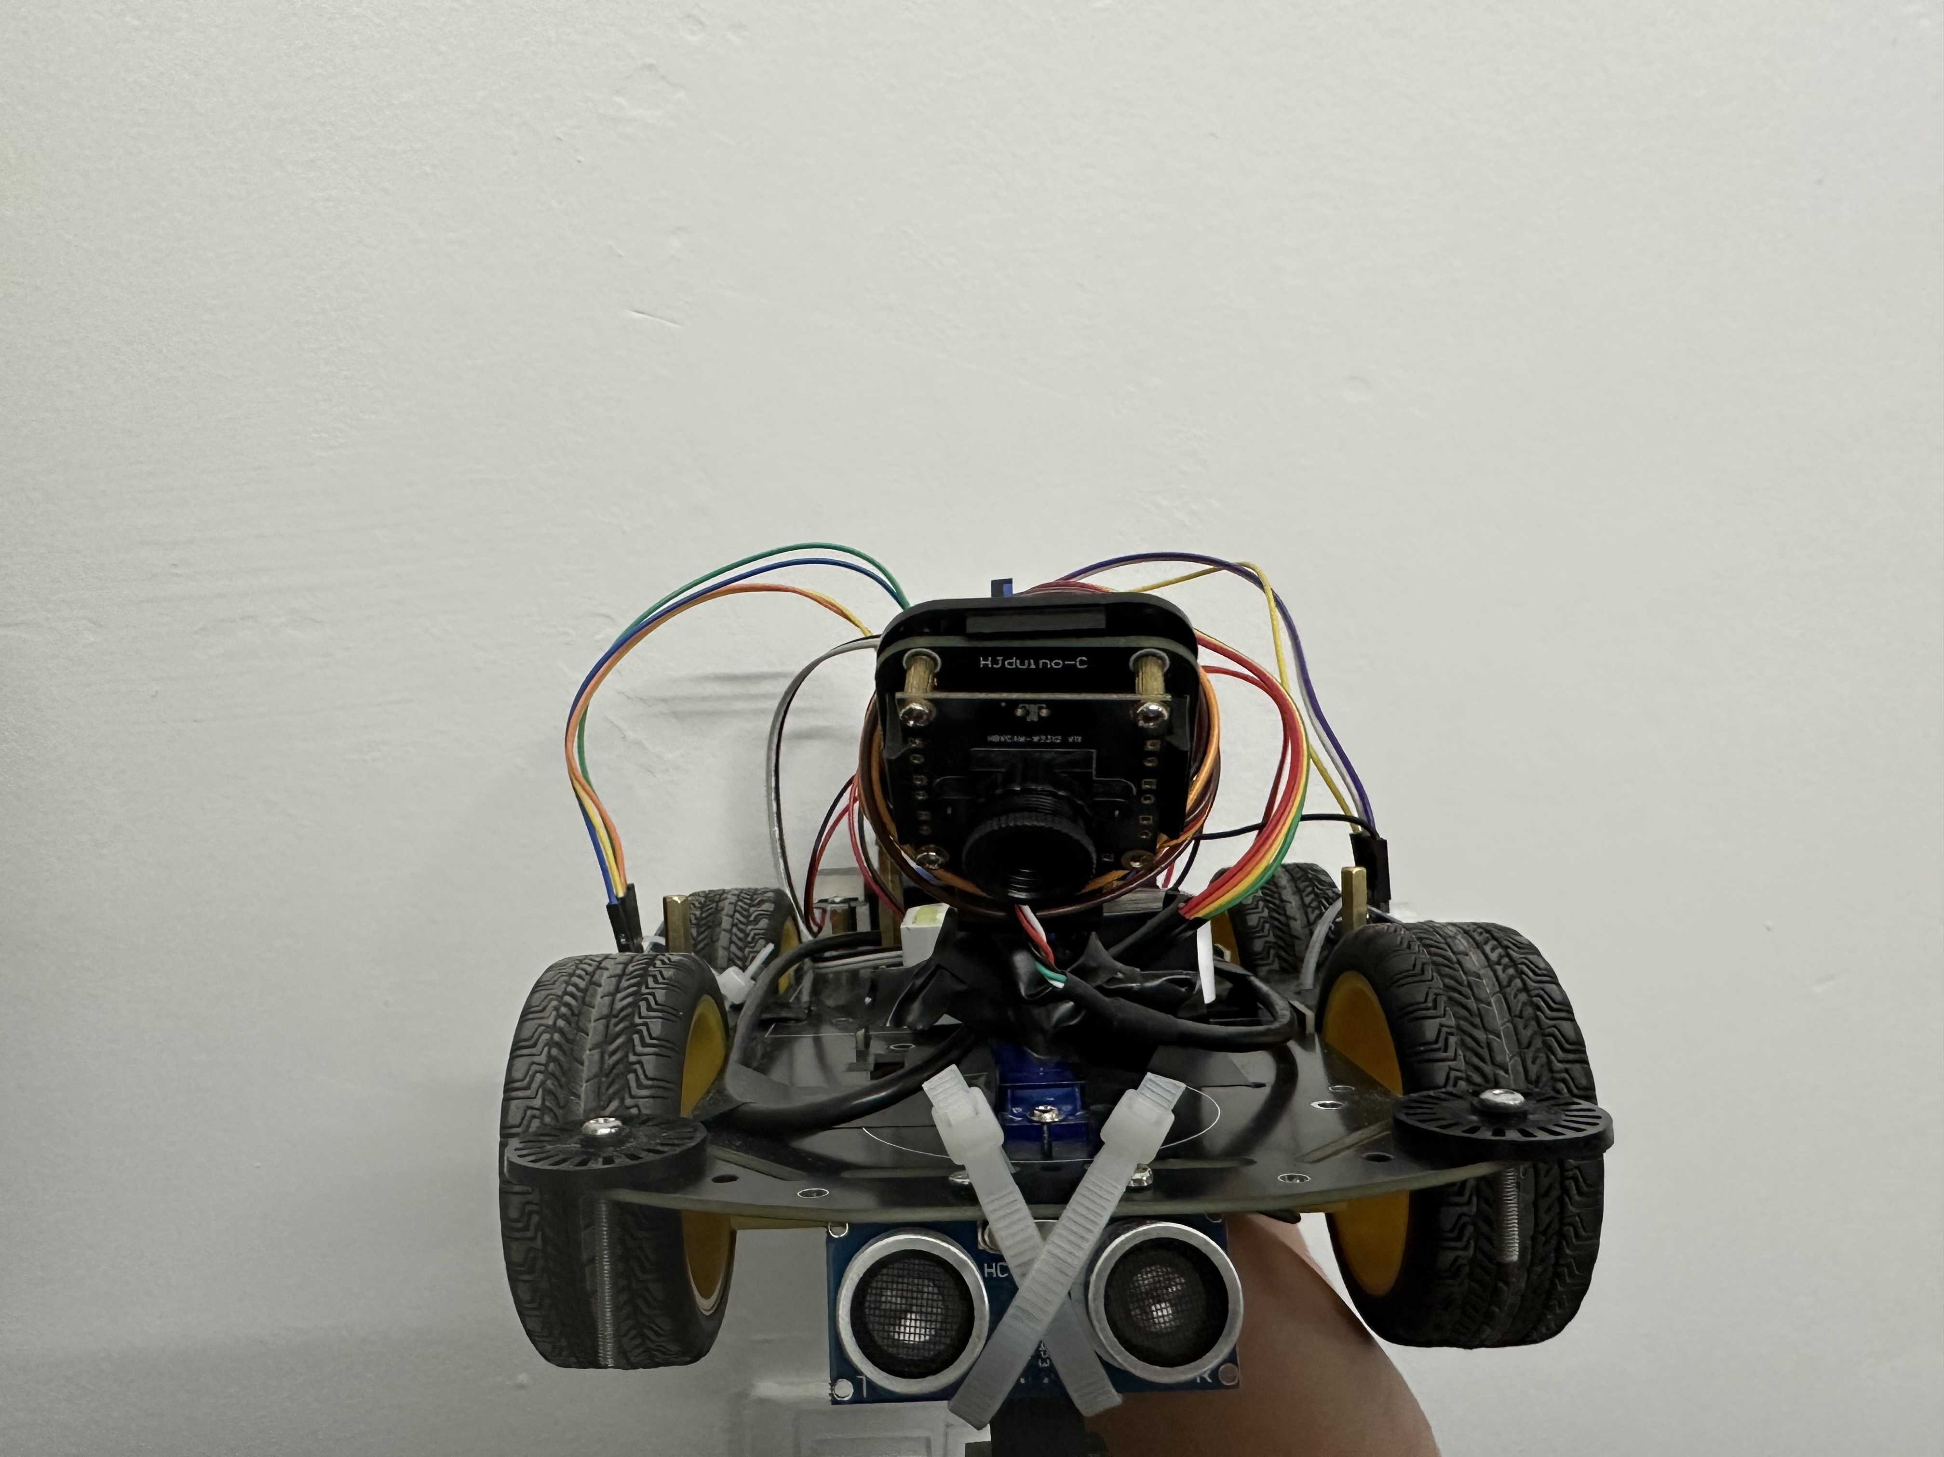
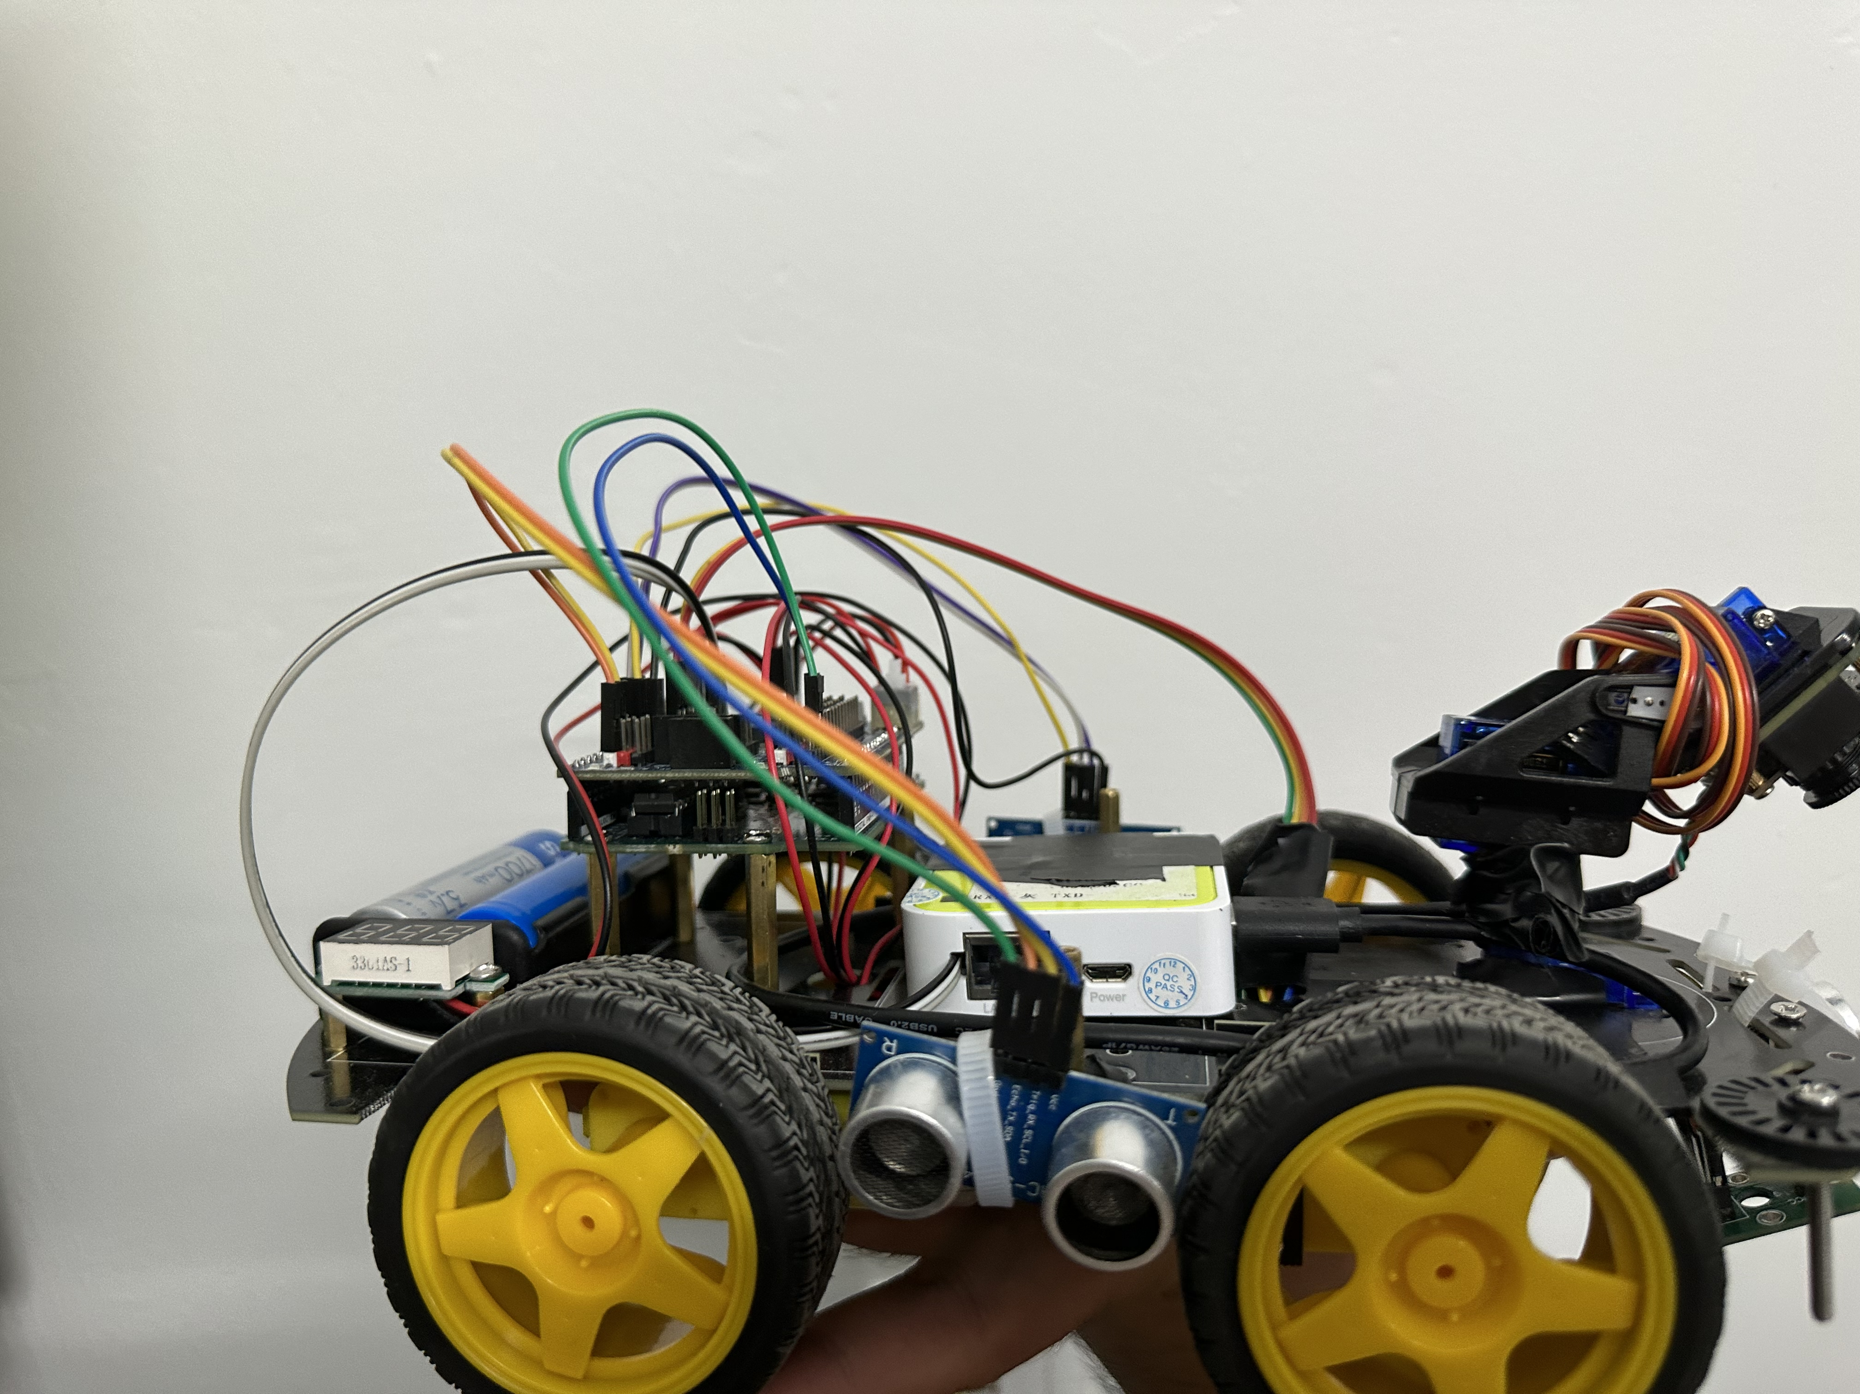
Achievements and appearance display

Slide 20





Object Detection Software
IoT Group Member:
Chang Yuchong, Song Wenbo, Wang Yichen

Slide 21
01
Design Ideas

Slide 22
Purpose
To help the robot find the treasure in the maze, we build object detection software.
Design Ideas
Transmission module
Detection module
Demonstration module

Slide 23
Transmission module:
Using Wi-Fi to transmit photos taken by the robots in real time.
Detection module: Based on YOLOv8.
YOLOv8 is a state-of-the-art (SOTA) model for image classification, object detection and instance segmentation. It is the latest update of the YOLO series, which was open-sourced by Ultralytics in January 2023.
Demonstration module: Use Java write a GUI to demonstrate the output.
Database Management and Web Visualization
Object Detection Software
Transmission Module
Demonstration Module
Result of detection
Result of detection
Detection Module
photos
photos
Result of detection
Hardware Model and Control Software

Slide 24
Why YOLOv8
Speed:
Both YOLOv8 and YOLOv5 are fast object detection models, capable of processing images in real-time. However, YOLOv8 is faster than YOLOv5, making it a better choice for applications that require real-time object detection1.
Accuracy:
Accuracy is a critical factor to consider when choosing an object detection model. In this regard, YOLOv8 is more accurate than YOLOv5, thanks to the several improvements made in its architecture1.
Ease of use:
Both YOLOv8 and YOLOv5 are easy to use, with YOLOv5 being the easiest to use of the two1.
Anchor-free approach:
The anchor-free approach eliminates the need for predefined anchors, which makes the model more flexible and robust to object size variations

Slide 25
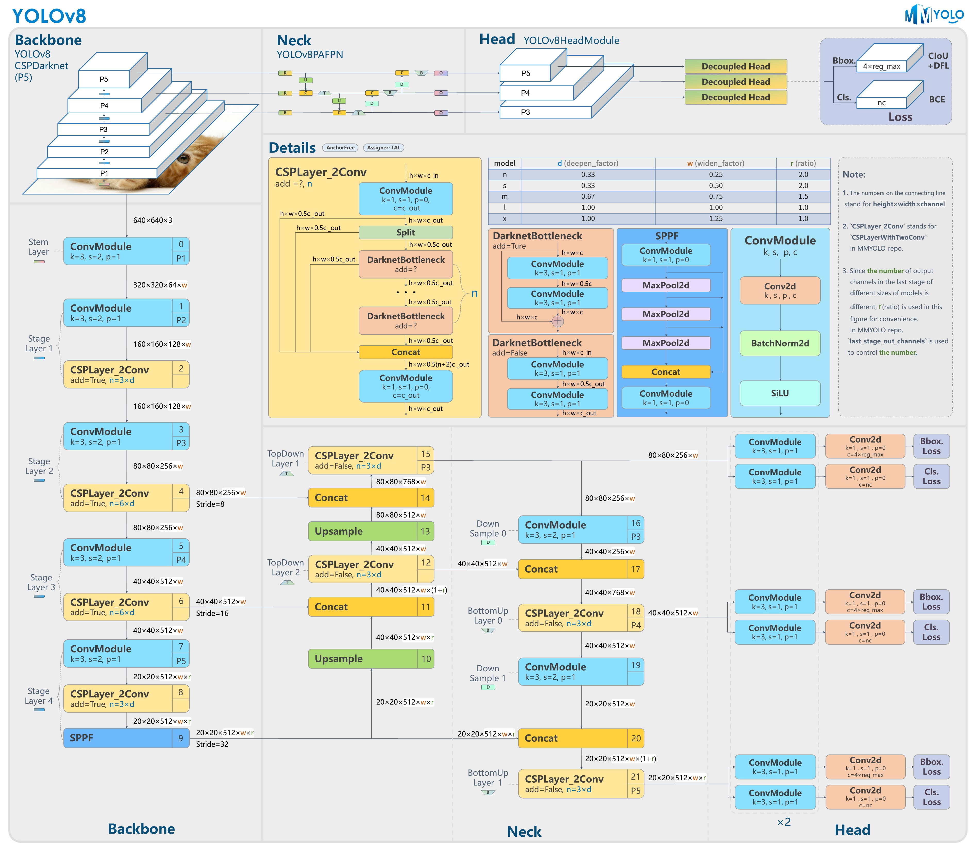
YOLOv8 model structure

Slide 26
02
Specific Function

Slide 27
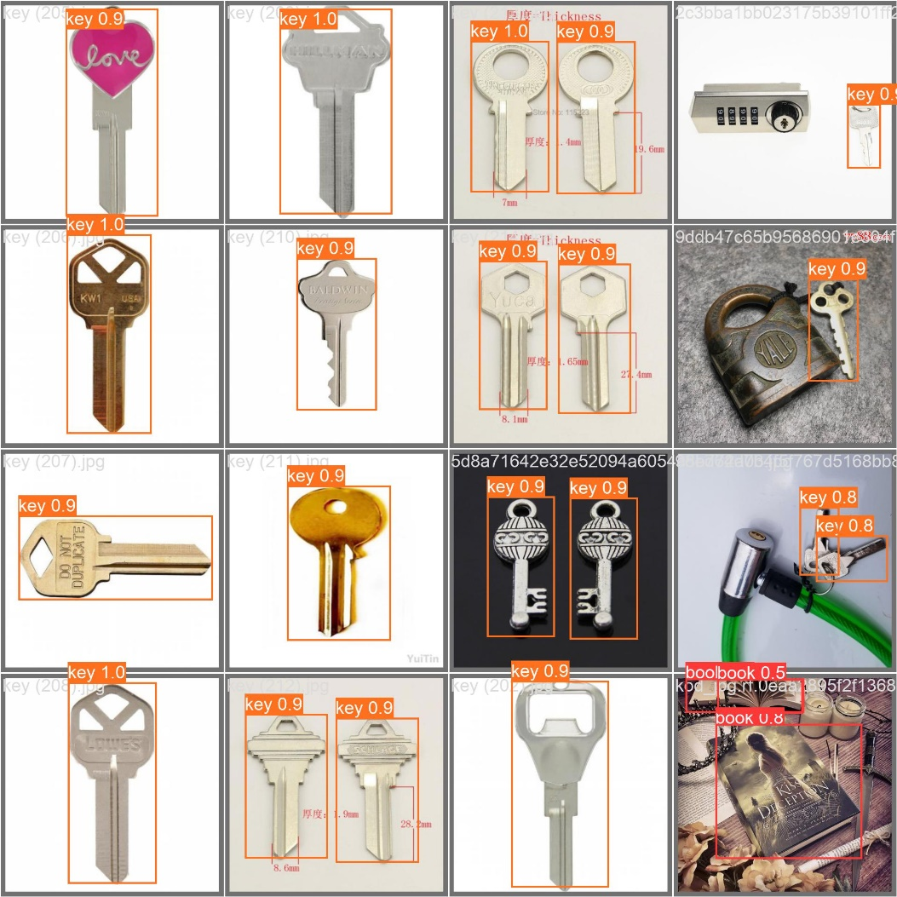
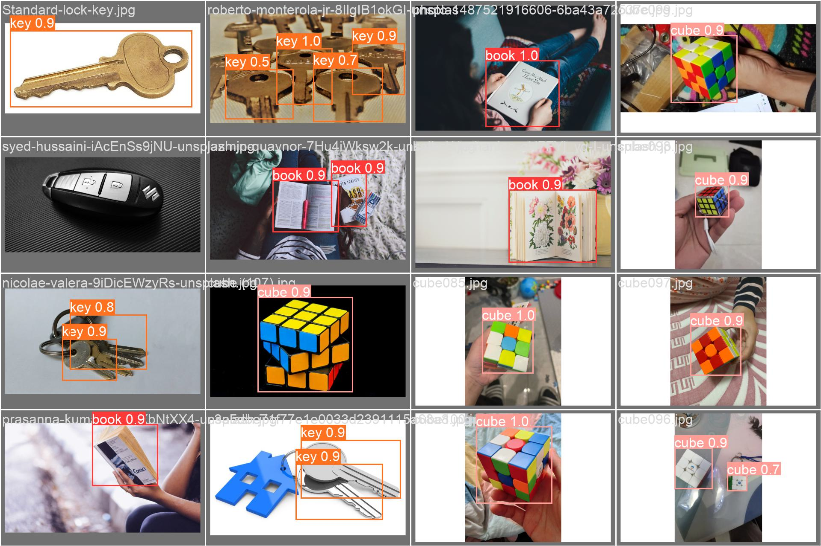
Detection: Find the chosen objects (to be used as treasures)
If there is a target object in the image, it will be marked with a color block.
The higher quality the picture has, the more effective it can be.

Slide 28
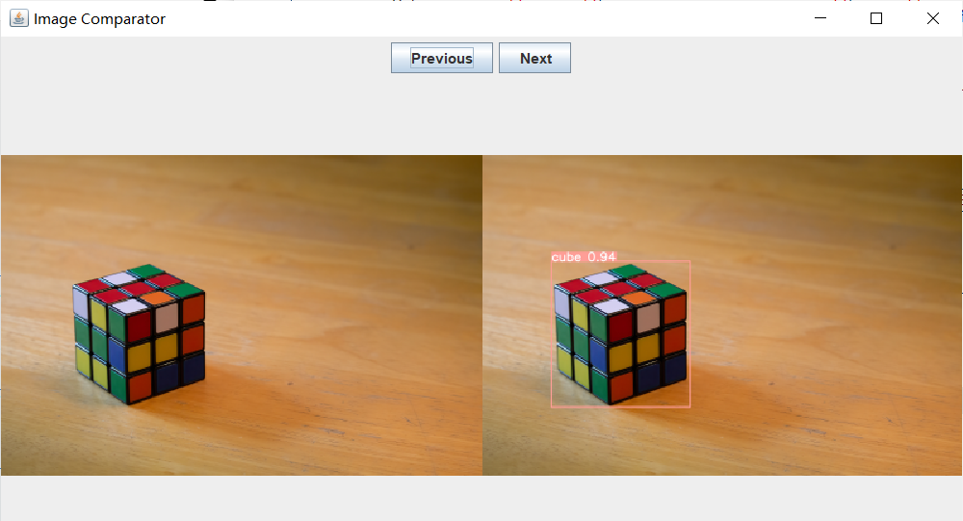
Visualization: Produce a GUI to demonstrate the accuracy

Slide 29
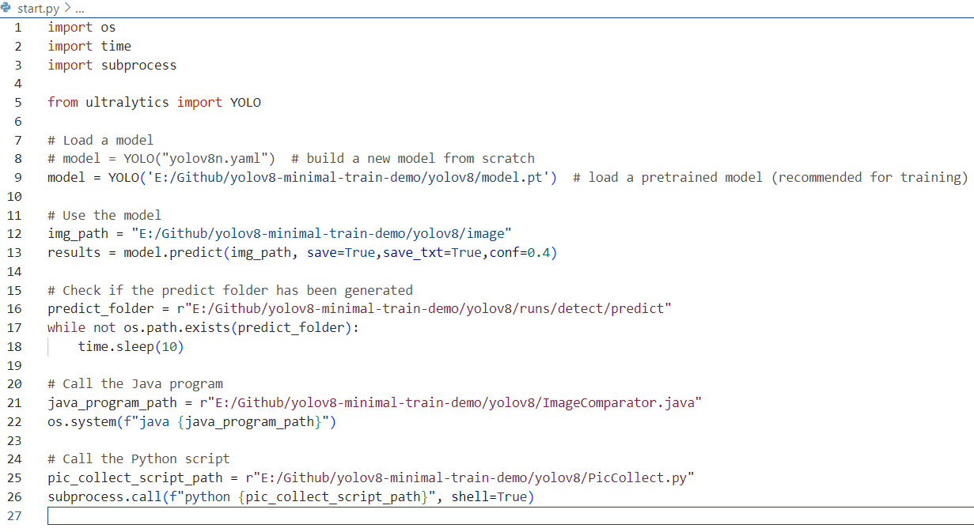
Appendix

Slide 30
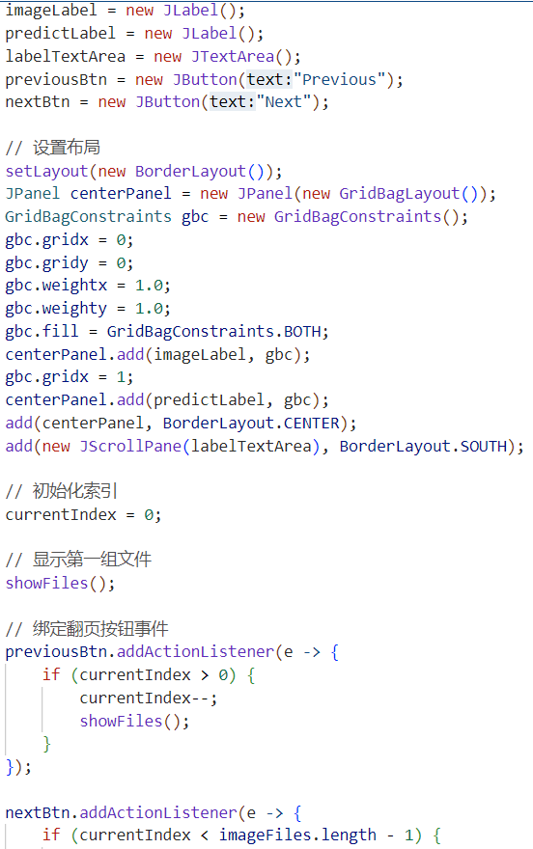
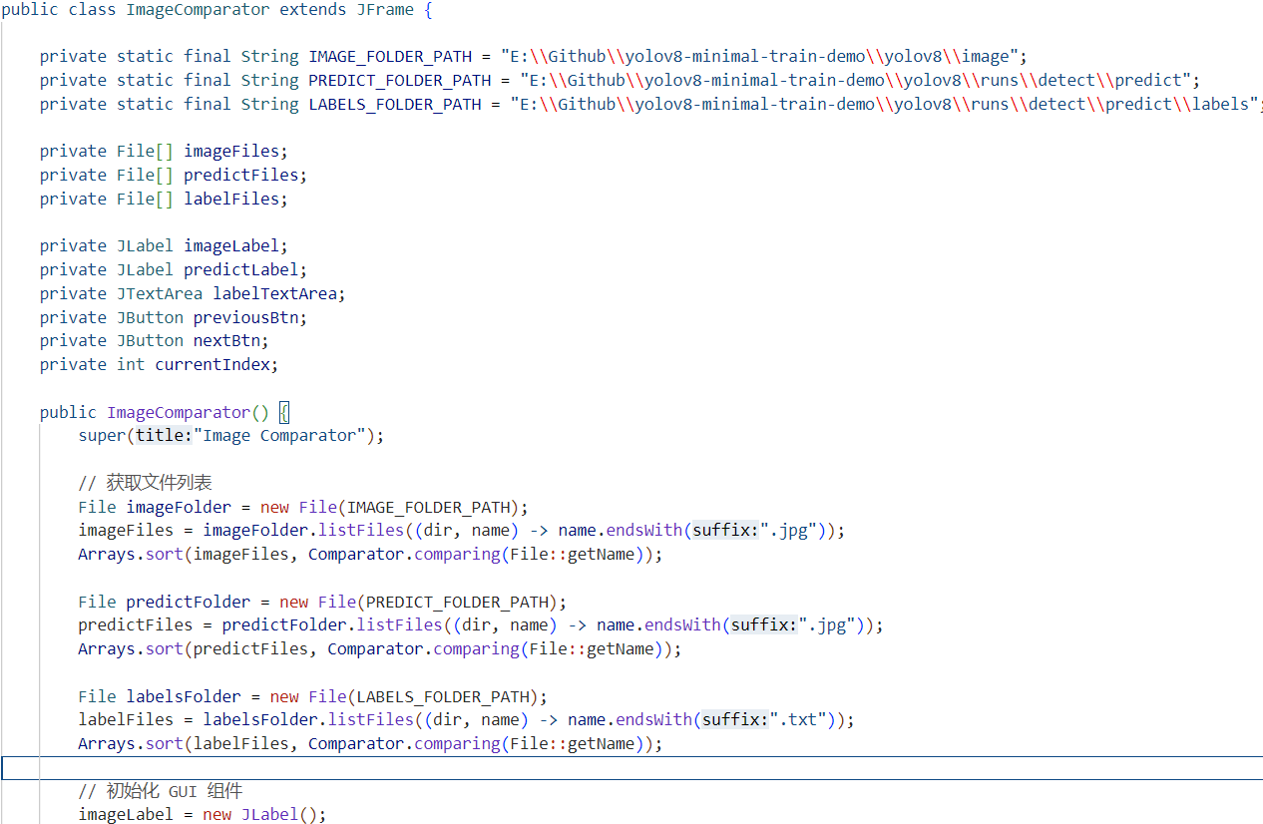
Appendix

Slide 31
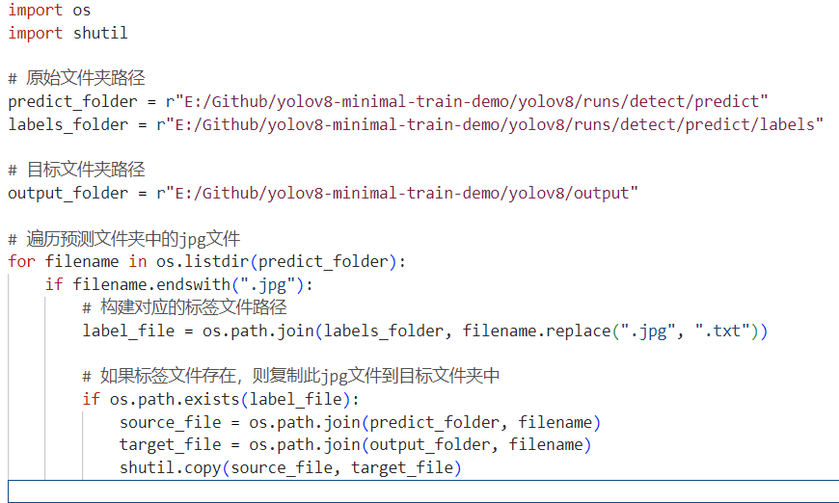
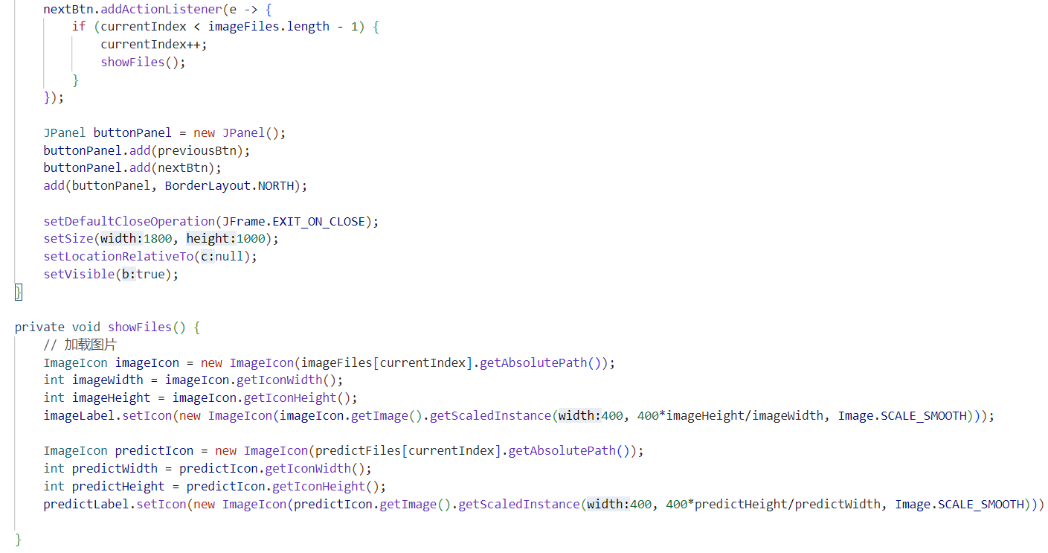
Appendix

Slide 32
What have we done
Train & calibrate the object detection algorithm for new, specific objects.
We found that the original model in YOLOv8 has bad performed in the detection of the chosen objects, so we retrained the model based on YOLOv8 model.
Prepare dataset
We collected 1894 images with the chosen objects (including negative samples), then labelled and divided them into training set, test set, and valid set (with proportion 3:1:1)
Train the model
We used a python script to train the model.
Evaluate the model and iteration
We tested the trained model and evaluated the performance.
Iterate several times to improve the model.
Build GUI
Handover with other group members

Slide 33

Database Management and Web Visualisation
E-commerce major
Student name：Qi Liu Wen Fan

Slide 34
01
Specific function
Directory
02
Web display
03
Team division of labor

Slide 35
01
Specific function

Slide 36
E-commerce major
Web login: Users can log in to the system by entering a name and password
Add within the web: Users can add information about the robot
Delete from web: Users can delete robot related information
Modification in the web: Users can modify the robot related information
Note: Robot related information includes robot number, name, weight, size, image.
Visual robot exploring maze records:
Robot exploration path visualization
Robot exploration time visualization
Visualization of robot taking treasure picture

Slide 37
02
Web display

Slide 38
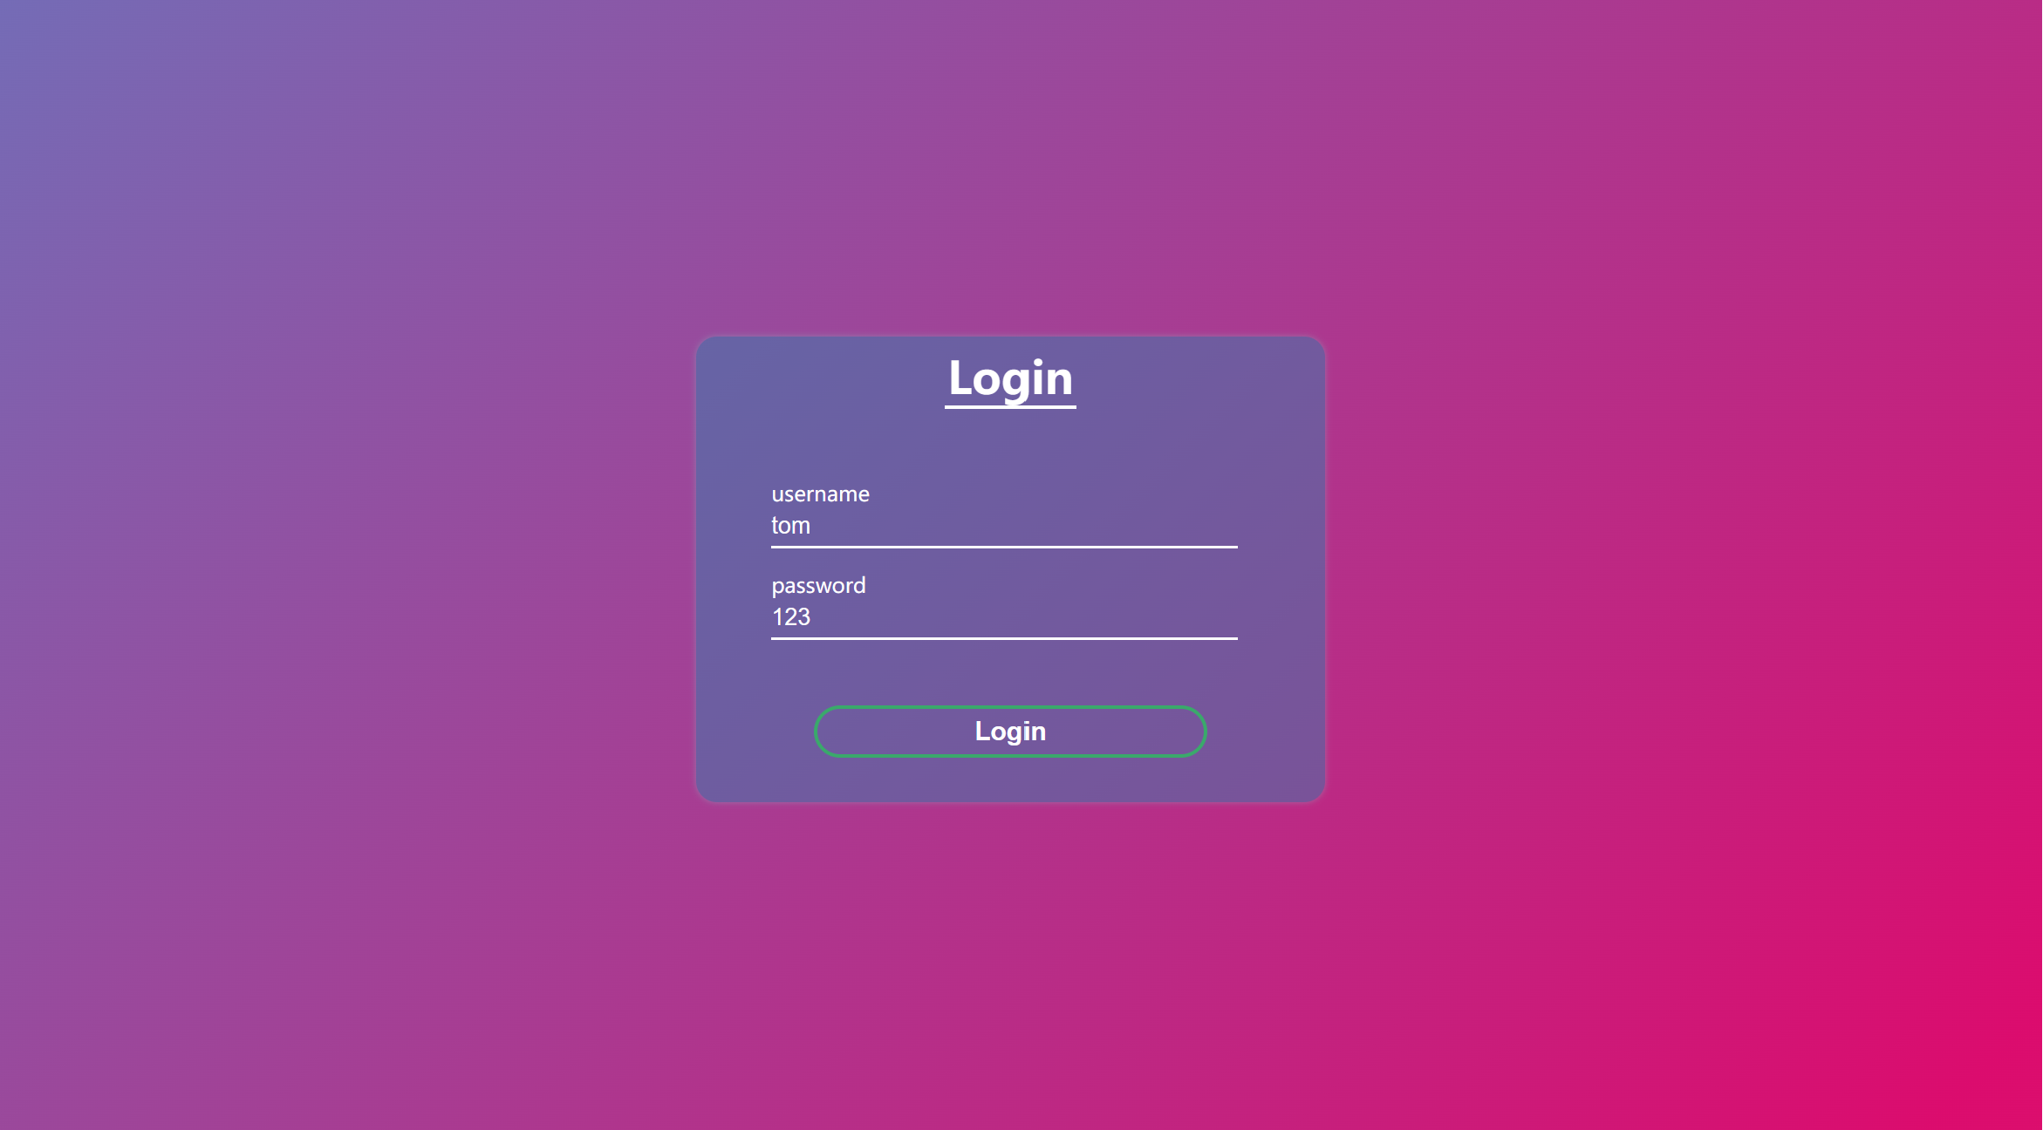
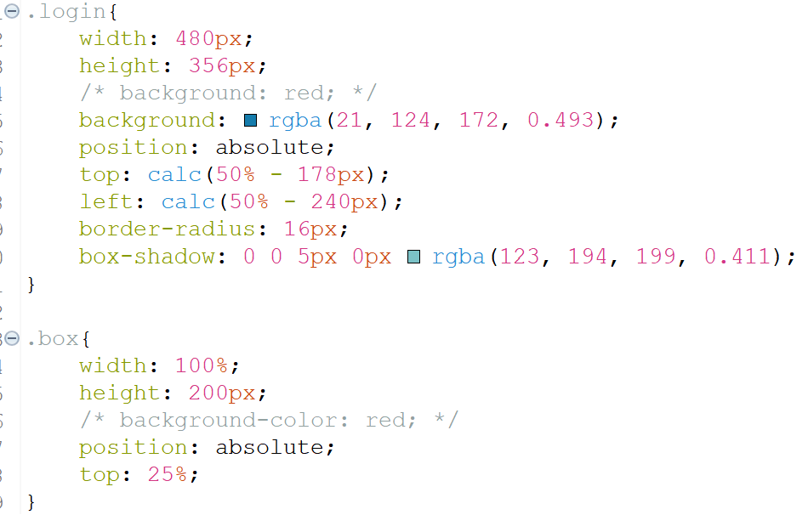
This is our login page with a continuely shining background.

Slide 39
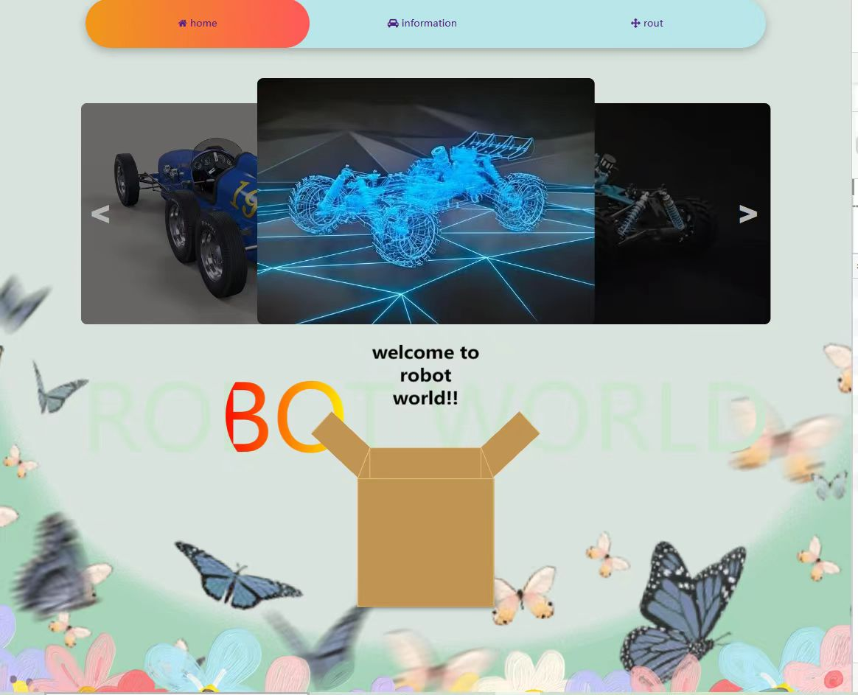
This is our main page with three buttons at the top to choose from. In the middle of the page is a rotograph where we can see different types of robot models. At the bottom of the page is a surprise box that pops up ‘ welcome to robot world!!’ when users click on it.

Slide 40
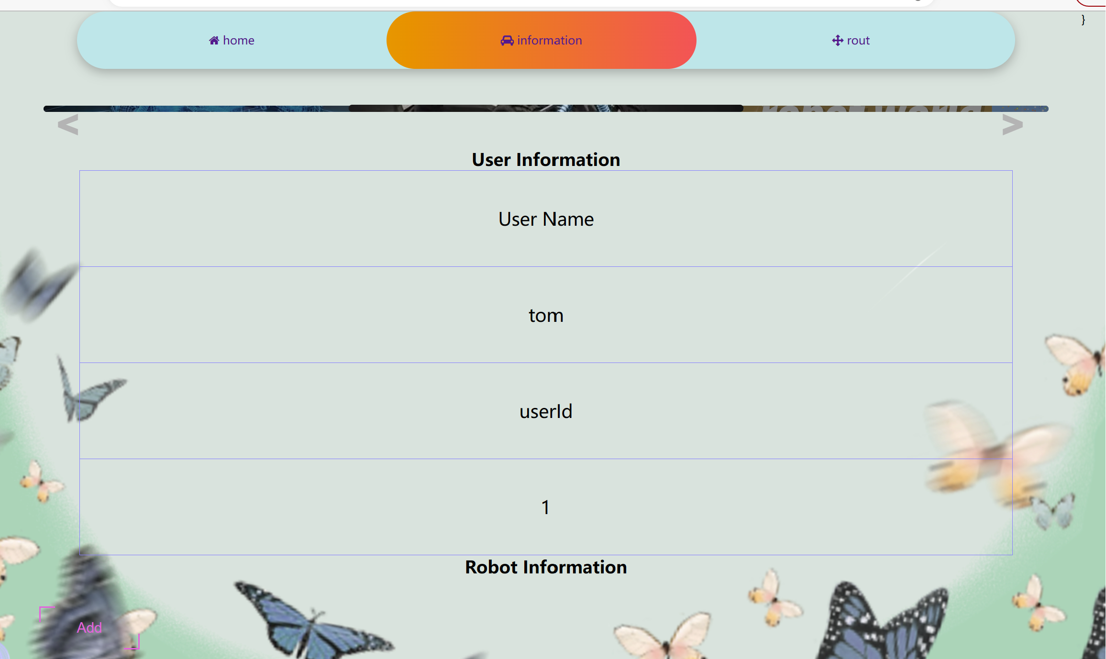
This is our information page, in this page we can view the user's personal information and its robot information and can add, delete and modify the robot information. Each button lights up and becomes visible when clicked by the user.

Slide 41
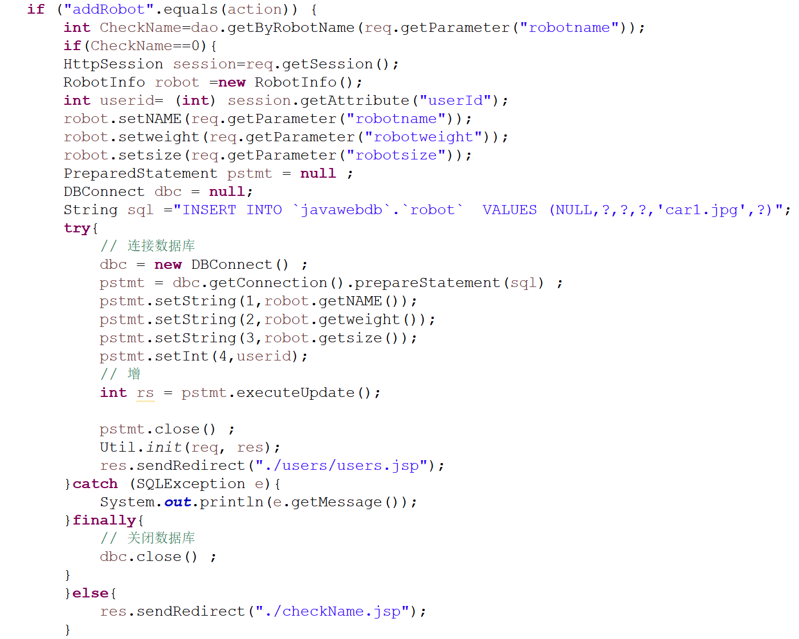
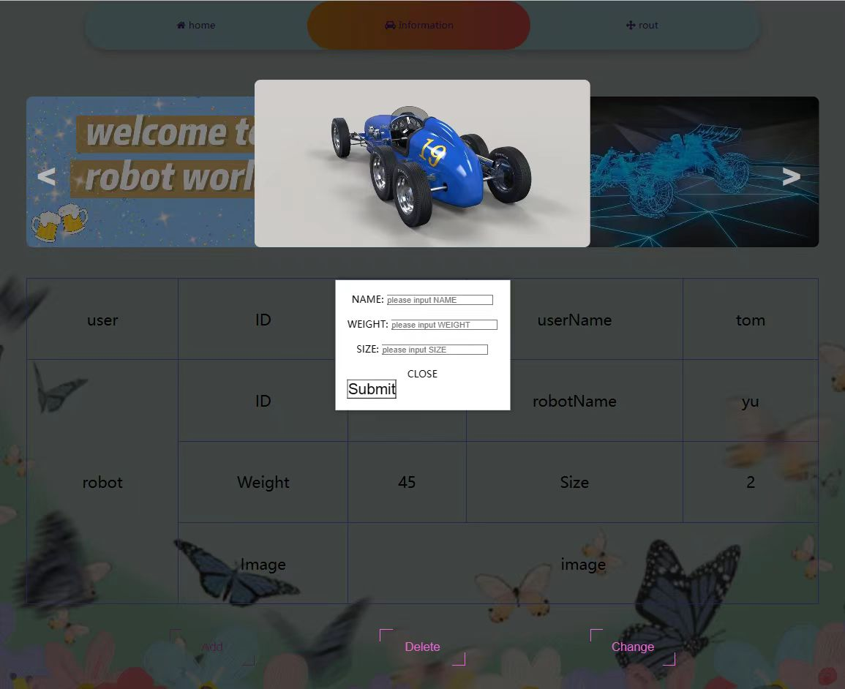
This is our button popup. In different pop-ups corresponding to different buttons, users can add, delete and modify information such as the name, weight and size of the robot. And the changed information will be displayed on the web page.

Slide 42
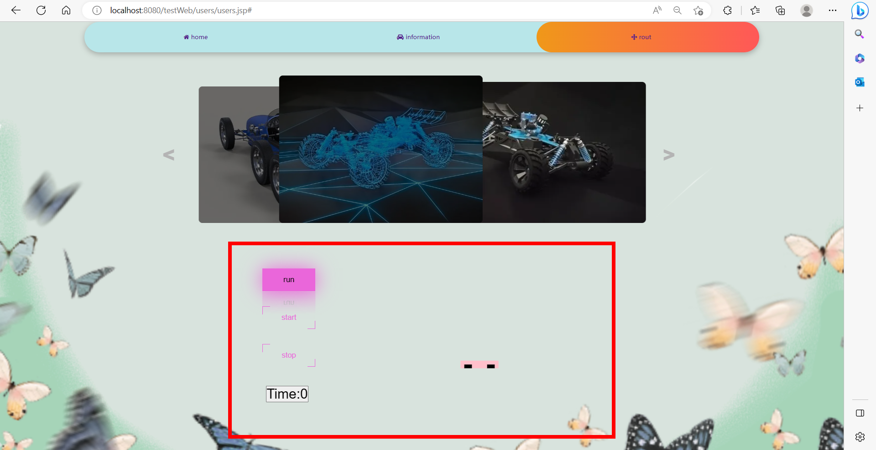
This is our path page. The user can control the robot to start action with the run button, and the path displayed by the robot on the web page is its actual exploration path.
The user can control the start and end of the timing through the start and stop buttons. The robot's exploration time is then displayed below the button.

Slide 43
03
Team division of labor

Slide 44
Wen Fan : Web login Deletion Modification
Css Pages
Robot exploration path visualization
Robot exploration time visualization
Visualization of robot taking treasure picture
Qi Liu : Web login Add
Web visualization of add, deletion, modification and check information

Slide 45
Teamwork
Image returned by the camera is recognized by IoT.
Students from IoT send back the left-right turn logic through Bluetooth to let students from E-commerce to make web pages.

Slide 46
Thank you and look forward to your correction

